Slide 1

The Starbucks exploration
02/06/2020

Slide 2
Introduction
As of May 2020, Starbucks is present in over 30,000 locations, on 6 continents and 79 countries.
Year | Revenue in mil. US$ | Net income in mil. US$ | Total Assets in mil. US$ | Average Price per Share in US$ | Employees
2013 | 14867 | 8 | 11517 | 33.71 | 182000
2014 | 16448 | 2068 | 10753 | 37.78 | 191000
2015 | 19163 | 2757 | 12416 | 53.25 | 238000
2016 | 21316 | 2818 | 14313 | 56.59 | 254000
2017 | 22387 | 2885 | 14366 | 57.27 | 277000
2018 | 24720 | 4518 | 24156 | 57.50 | 291000
2019 | 26509 | 3599 | 19220 | 81.44 | 346000

Slide 3
Business Problem
Where to open a new store in Europe?

Slide 4
Approach
1) Find which cities have the most (reference) and the fewest (target) stores.
2) Find the most popular store in the reference city and its area (reference neighbourhood).
3) Characterize the target city neighbourhoods along with the reference city neighbourhood.
4) Assess the similarity between target city and reference neighbourhood.

Slide 5
Starbucks in Europe
City | Country | Officialpopulation | StarbucksStoresCount | Inhabitants / Starbucks
Nizhny Novgorod | Russia | 1259013 | 0 | inf
Saint Petersburg | Russia | 5383890 | 0 | inf
Perm | Russia | 1051583 | 0 | inf
Ufa | Russia | 1121429 | 0 | inf
Kiev | Ukraine | 2950800 | 1 | 2.950800e+06
Minsk | Belarus | 1982444 | 1 | 1.982444e+06
Kharkiv | Ukraine | 1451132 | 1 | 1.451132e+06
Rome | Italy | 2844750 | 2 | 1.422375e+06
Tekirdağ | Turkey | 1055412 | 1 | 1.055412e+06
Volgograd | Russia | 1013533 | 1 | 1.013533e+06
Voronezh | Russia | 1054537 | 2 | 5.272685e+05
Odessa | Ukraine | 1011494 | 2 | 5.057470e+05
Belgrade | Serbia | 1397939 | 3 | 4.659797e+05
Samara | Russia | 1170910 | 3 | 3.903033e+05
Istanbul | Turkey | 15519267 | 50 | 3.103853e+05
Moscow | Russia | 12615279 | 50 | 2.523056e+05
Kazan | Russia | 1243500 | 5 | 2.487000e+05
London | United Kingdom | 9126366 | 50 | 1.825273e+05
Milan | Italy | 1390434 | 8 | 1.738042e+05
Berlin | Germany | 3748148 | 22 | 1.703704e+05
Rostov-on-Don | Russia | 1119875 | 7 | 1.599821e+05
Sofia | Bulgaria | 1238438 | 8 | 1.548048e+05
Hamburg | Germany | 1930996 | 14 | 1.379283e+05
Cologne | Germany | 1085664 | 8 | 1.357080e+05
Munich | Germany | 1471508 | 17 | 8.655929e+04

Slide 6
Starbucks in Europe
Cyrillic alphabet would make our search difficult, so we will focus on Western Europe.
Italy and Germany are good candidates.
We choose Rome which has only one store (which is in fact not part of the Starbucks franchise, but categorized by Foursquare as such).

Slide 7
Reference Starbucks
London is the city with the highest proportion of Starbucks per inhabitant. The most popular store according to Foursquare is 52 Berkeley St.
Name | Address | Rating | Likes
Starbucks | 52 Berkeley St. | 7.3 | 186
Starbucks | 10 Kingsway, Unit B2; St Catherines House | 7.3 | 70
Starbucks | 27 Berkeley St | 7.1 | 96
Starbucks | 34 Great Marlborough St, (Carnaby Street) | 7.0 | 108
Starbucks | 6A Vigo Street, London | 7.0 | 380
We will try to find an area in Rome similar to the one around this store.

Slide 8
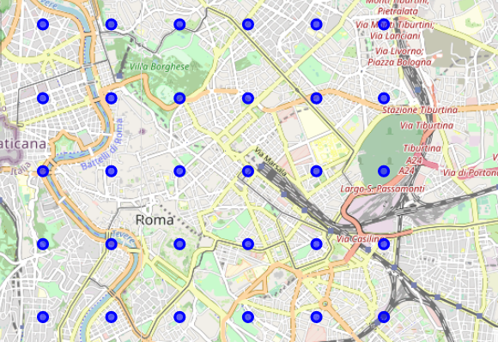
Neighbourhoods to explore in rome

Slide 9
Approach to characterize neighbourhoods
We search venues in each neighbourhood and list them:
We group these results by venue category and calculate their frequency for each neighbourhood:
Neigh. | Venue | Venue Latitude | Venue Longitude | Venue Category
London | The Ritz London | 51.507078 | -0.141627 | Hotel
London | Novikov | 51.507767 | -0.142850 | Asian Restaurant
London | Brown's Hotel | 51.509127 | -0.142077 | Hotel
London | Burger & Lobster | 51.507118 | -0.145477 | Seafood Restaurant
London | Prada | 51.508998 | -0.140959 | Boutique
----London----
venue freq
0 Store 0.17
1 Art 0.09
2 Boutique 0.05
3 Hotel 0.05
4 Lounge 0.04
----R0----
venue freq
0 Hotel 0.09
1 Plaza 0.06
2 Winery 0.06
3 Pizza Place 0.06
4 Café 0.06

Slide 10
Neighbourhood similarity
We use Pearson Correlation between London reference and each Rome neighbourhood venue category frequencies.
We select 3 neighbourhoods as good matches.
Neighbourhood | Correlation
London | 1.000000
R20 | 0.448627
R19 | 0.435693
R15 | 0.408138
R28 | 0.326147

Slide 11
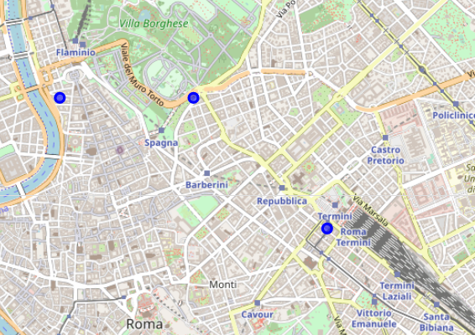
results
The 3 matches are located as follows in Rome:

Slide 12
Conclusion
We have 3 potential locations to open a new store, in Rome (Italy).
Among the points to improve the analysis:
Include challenging locations to the analysis,
Have an up to date list of existing stores,
Less limitations from the API,
Sorting venues in a better way.

